Slide 1
Swarm Robot
Course Code : MCTE 4362
Lecturer : Dr. Zulkifli bin Zainal Abidin
Slide by : Muhammad Iqmal Danish bin Hasnan (1912461)

Slide 2
History of Swarm Robot
This presentation provides an overview of the history of swarm robot, from their early development up to today’s usage.

Slide 3
Timeline
1980s-1990s
The concept of swarm robotics was inspired by social insects such as ants and bees.
The concept gained traction in the 1990s with researchers exploring the collective behaviors and distributed control of simple robots.
2000s
Researchers began developing mathematical models and algorithms for swarm robotics.
Studies focused on emergent behaviors, self-organization, and decentralized control strategies.
Researchers demonstrated various swarm capabilities such as aggregation, foraging, and formation control.
2010s
Swarm robots were used for tasks like environmental monitoring, search and rescue, construction, and surveillance.
Research expanded to include heterogeneous swarms with robots of different types and capabilities.

Slide 4
2010s-2020s
Swarm intelligence algorithms, inspired by collective behavior in natural systems, were increasingly applied to swarm robotics.
Optimization techniques like ant colony optimization and particle swarm optimization were adapted for multi-robot systems.
Swarm robotics research focused on scalable control, robustness, and fault tolerance.
Current Developments
Recent advancements in swarm robotics include the integration of artificial intelligence and machine learning techniques.
Swarm robots are being designed to adapt and learn from their environment, enabling more complex and flexible behaviors.
Research continues to explore new applications and refine swarm algorithms to improve efficiency and coordination.

Slide 5
Main Components of the Vehicle
Hull Design
Navigation System and Control
Data Transmission
Propulsion System
Data Collection
Power Management

Slide 6
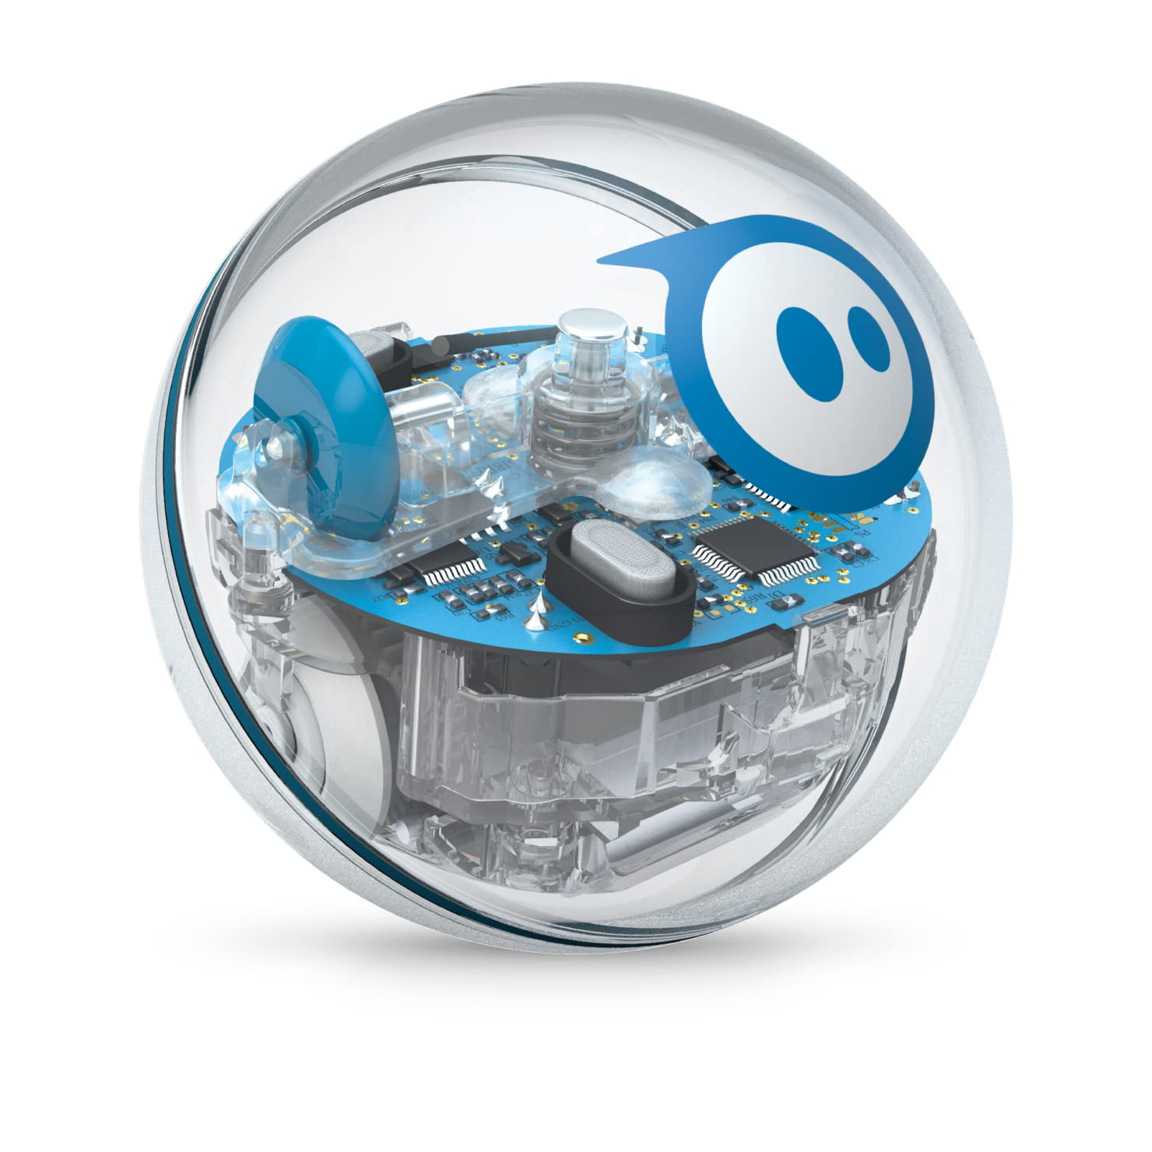
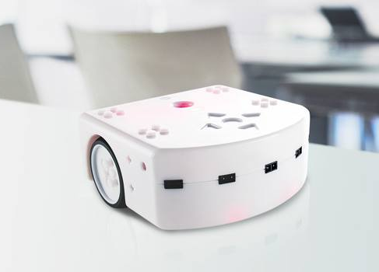
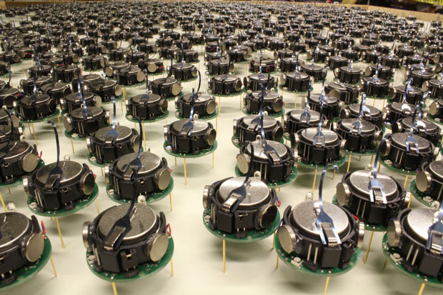
Hull Design
Sphero
Thymia
Kilobot
Spherical Design
Rectangular Design
Modular Design

Slide 7
Hull Design
Type | Spherical | Rectangular | Modular
Explanation | Spherical hull designs are characterized by a round shape resembling a sphere. This design allows for omnidirectional movement and even weight distribution. | Rectangular hull designs have a box-like shape with flat surfaces and right angles. This design allows for efficient space utilization and easy integration of components. | Modular hull designs consist of individual robotic units that can connect and disconnect to form different shapes and structures. These units can operate independently or work together as a swarm.
Advantages | Excellent maneuverability, Can easily navigate in tight spaces Uniform weight distribution | Versatile and modular design Easy integration of sensors and payloads Good stability | Flexibility in formation and task allocation Fault tolerance Scalability
Disadvantages | Limited payload capacity Reduced stability on uneven terrains | Limited maneuverability in complex environments Increased weight and cost | Complex coordination and communication requirements, design and control.
Applications | Exploration in confined spaces, search and rescue in collapsed structures. | Warehouse logistics, material handling, collaborative assembly. | Swarm coordination and collaboration, distributed sensing and mapping.
Model | Sphero | Thymio | Kilobot Swarm

Slide 8
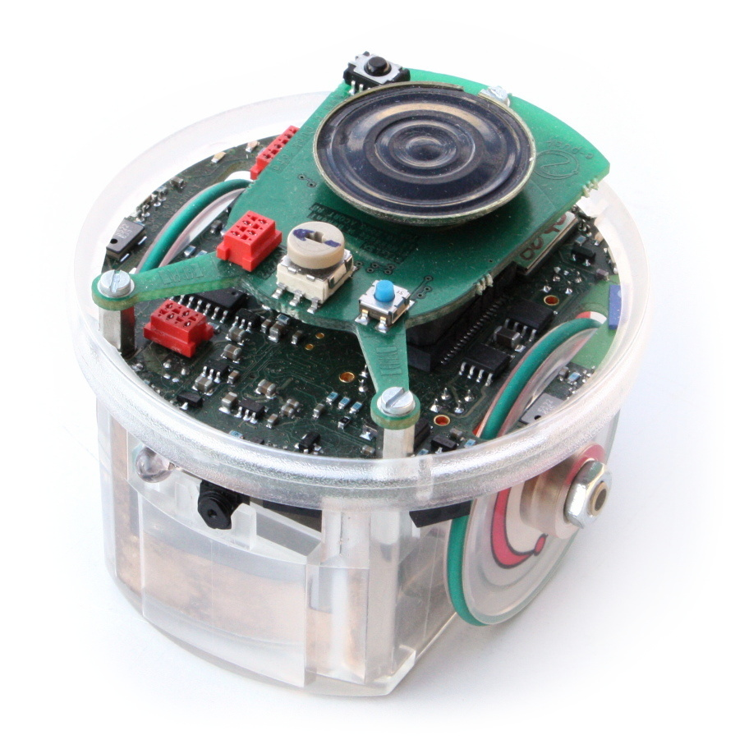
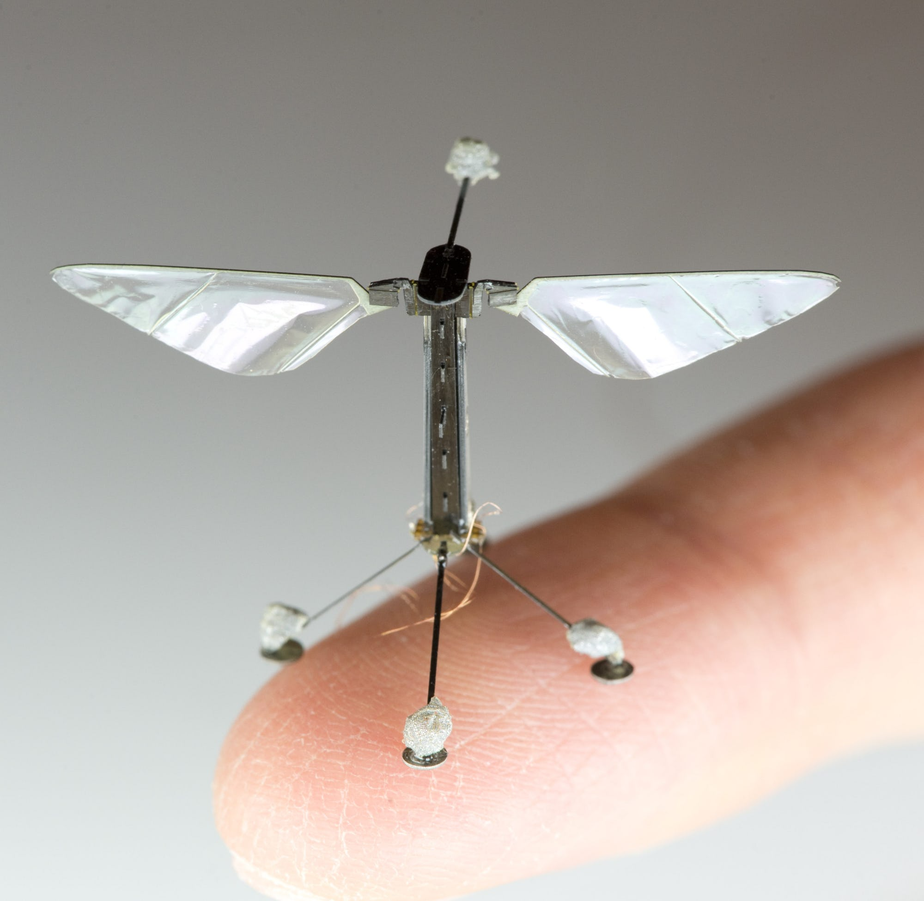
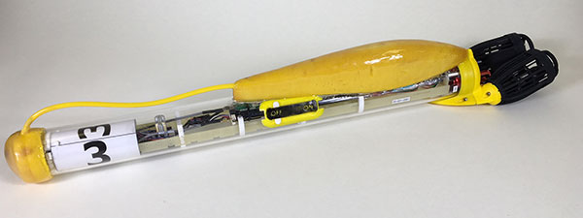
Propulsion System
e-puck
RoboBee
SwarmDiver
Wheeled
Flying
Swimming

Slide 9
Propulsion System
Type | Wheeled Propulsion | Flying Propulsion | Swimming Propulsion
Explanation | Wheeled propulsion systems use wheels or tracks to move the swarm robot on a surface. They can have differential or omnidirectional wheel configurations. | Flying propulsion systems enable swarm robots to navigate through the air using wings or rotors. They can have fixed-wing or rotary-wing configurations. | Swimming propulsion systems allow swarm robots to operate in water. They can have various fin or propeller configurations.
Advantages | Simple and efficient locomotion, good maneuverability on flat surfaces, low energy consumption. | Rapid mobility, ability to traverse obstacles, aerial coverage, three-dimensional exploration. | Efficient underwater locomotion, ability to navigate submerged areas, aquatic data collection.
Disadvantages | Limited mobility on rough or uneven terrain, challenges in climbing obstacles. | Higher energy consumption, limited payload capacity, flight regulations and safety concerns. | Challenges in communication and coordination underwater, limited battery life.
Applications | Indoor navigation, warehouse logistics, structured environments. | Aerial surveillance, environmental monitoring, swarm-based aerial formations. | Underwater exploration, environmental monitoring, marine research.
Model | e-puck | RoboBee | SwarmDiver

Slide 10
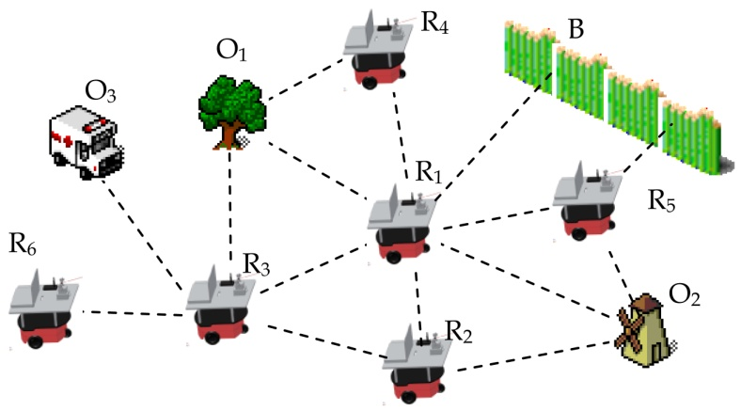
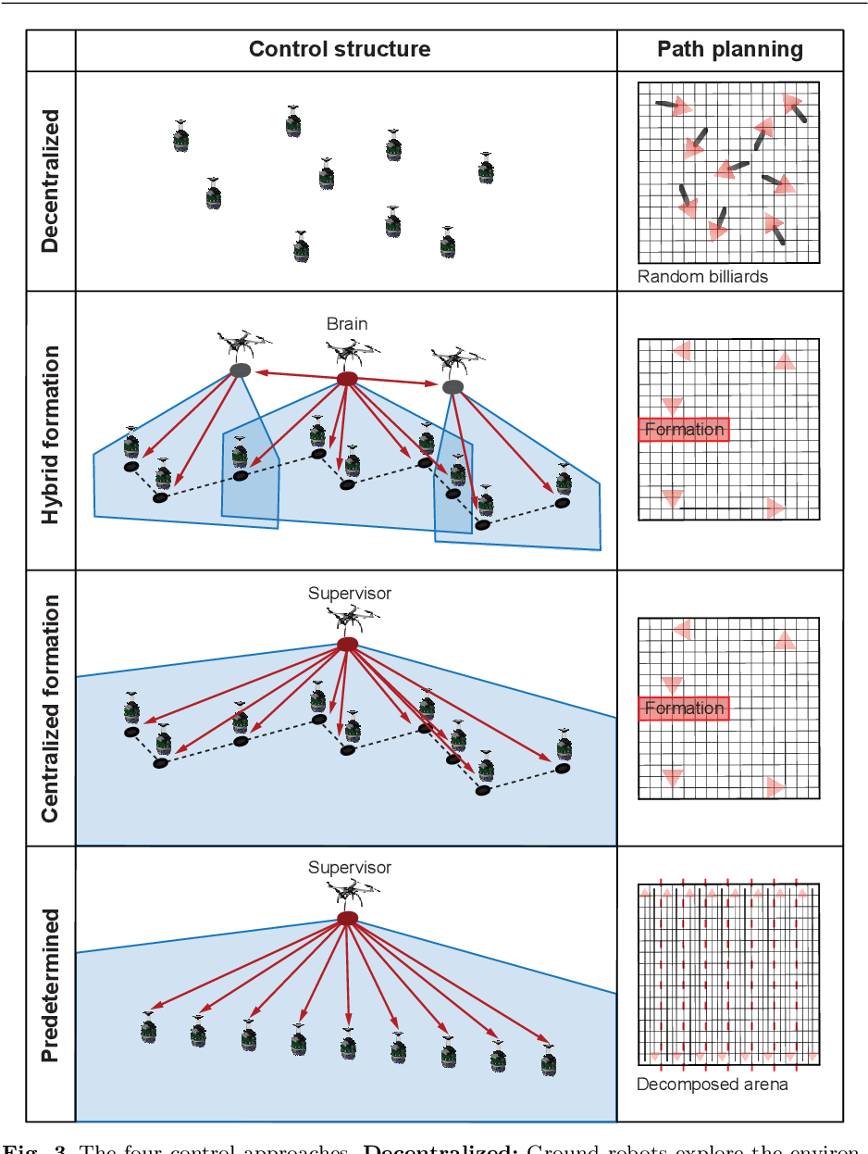
Navigation System & Control
Centralized Control
Distributed Control
Decentralized Control

Slide 11
Navigation System & Control
Type | Centralized Control | Decentralized Control | Distributed Control
Explanation | In centralized control, a single central entity coordinates the actions of all swarm robots. The central controller receives sensor data and issues commands to individual robots. | Decentralized control allows swarm robots to make autonomous decisions based on local sensing and limited communication with neighboring robots. Each robot operates independently with local rules or algorithms. | Distributed control combines elements of both centralized and decentralized control. The control is distributed among different entities or levels, where higher-level controllers provide overall guidance and lower-level controllers manage individual robot behaviors.
Advantages | Simplified coordination, global optimization, efficient resource allocation. | Robustness to individual robot failure, scalability, flexibility. | Combination of global coordination and local autonomy, scalability, fault tolerance.
Disadvantages | Single point of failure, increased communication overhead, limited scalability. | Lack of global optimization, potential for conflicts or collisions, limited coordination capabilities. | Increased complexity, challenges in maintaining synchronization, communication requirements.
Applications | Swarm formation control, synchronized movement, collaborative tasks. | Swarm exploration, collective decision-making, self-organized formations. | Cooperative tasks, dynamic environments, heterogeneous swarms.
Model | Cyro | S-bot | Kilobot

Slide 12
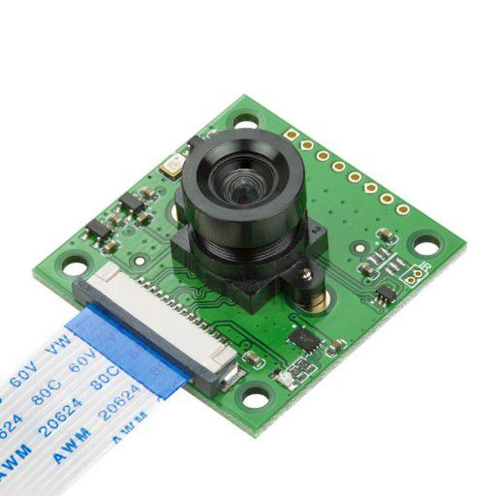
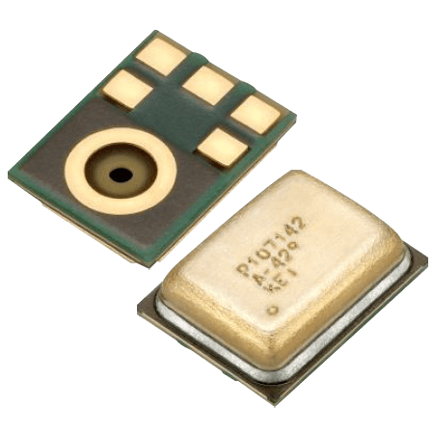
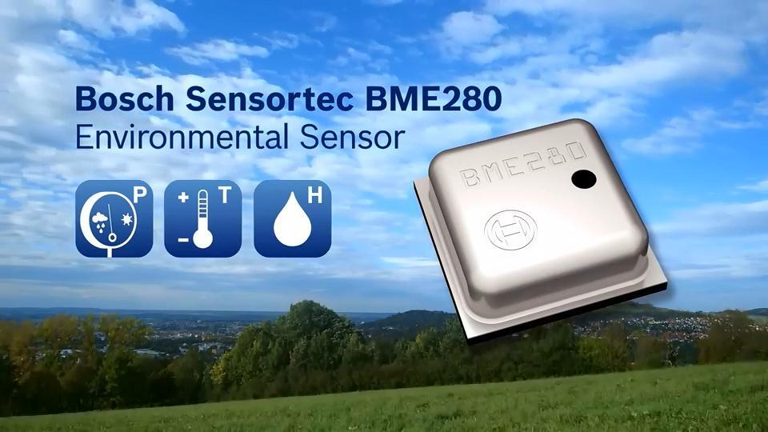
Data Collection (Payload)
Bosch Sensortec BME280
Sony IMX219
Knowles SPH0645LM4H
Environmental Sensor
Visual Sensor
Audio Sensor

Slide 13
Data Collection (Payload)
Type | Environmental Sensors | Visual Sensors | Audio Sensors
Explanation | Environmental sensors are designed to collect data about the physical characteristics of the robot's surroundings, such as temperature, humidity, gas concentration, or air quality. | Visual sensors, such as cameras or image sensors, enable swarm robots to capture images or video of their surroundings. | Audio sensors or microphones allow swarm robots to capture sound or acoustic data in their environment.
Advantages | Provide valuable information about the environment, enable monitoring and analysis, assist in hazard detection or mapping. | Rich and detailed data collection, object recognition and tracking, visual mapping. | Detection of sound patterns, event monitoring, localization of sound sources.
Disadvantages | Limited in their ability to capture detailed or localized data, may require calibration and maintenance. | High computational requirements for image processing, limited field of view, sensitivity to lighting conditions. | Limited range, susceptibility to background noise, challenges in signal processing.
Applications | Environmental monitoring, pollution detection, climate research. | Surveillance, mapping, object identification. | Acoustic monitoring, sound source localization, wildlife tracking.
Model | Bosch Sensortec BME280 | Sony IMX219 | Knowles SPH0645LM4H

Slide 14
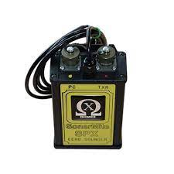
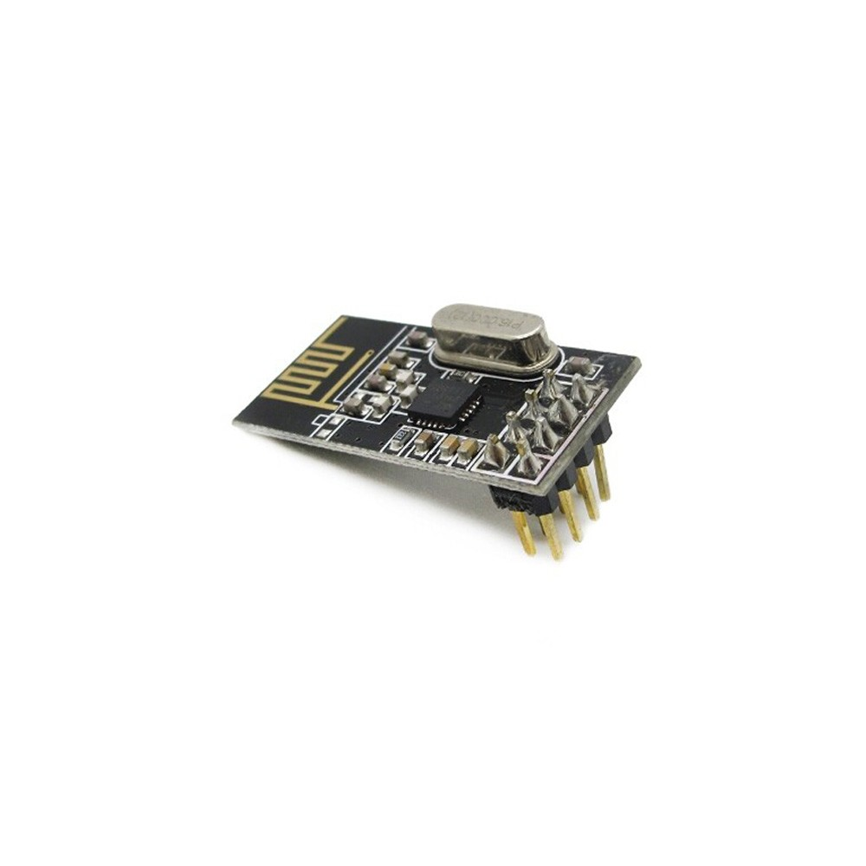
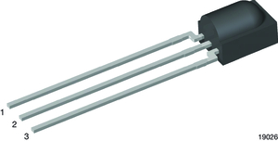
Data Transmission (Communication)
Nordic Semiconductor nRF24L01
Vishay Semiconductors TSOP382
SonarMite
Radio Frequency
Infrared
Acoustic

Slide 15
Data Transmission (Communication)
Type | Radio Frequency (RF) Communication | Infrared (IR) Communication | Acoustic Communication
Explanation | RF communication involves the transmission of data using radio waves. Swarm robots equipped with RF modules can exchange information wirelessly within a certain range. | IR communication utilizes infrared light signals to transmit data between swarm robots. It is typically used for short-range communication. | Acoustic communication involves the transmission of data using sound waves. Swarm robots equipped with acoustic transducers can communicate through audio signals.
Advantages | Wide range of coverage, can transmit data in real-time, suitable for large-scale swarm coordination. | Simple and low-cost implementation, less susceptible to interference than RF, line-of-sight communication. | Suitable for underwater or underground environments, can propagate over long distances, less affected by obstacles than RF.
Disadvantages | Limited bandwidth, susceptibility to interference, potential for signal degradation over distance. | Limited range, sensitivity to environmental condition such as obstacles or ambient light. | Limited bandwidth, susceptible to background noise, slower data transmission.
Applications | Swarm coordination, data sharing, collaborative tasks. | Local swarm coordination, obstacle avoidance, swarm localization. | Underwater swarm coordination, animal-inspired swarm behaviors, remote monitoring.
Model | Nordic Semiconductor nRF24L01 | Vishay Semiconductors TSOP382 | SonarMite

Slide 16
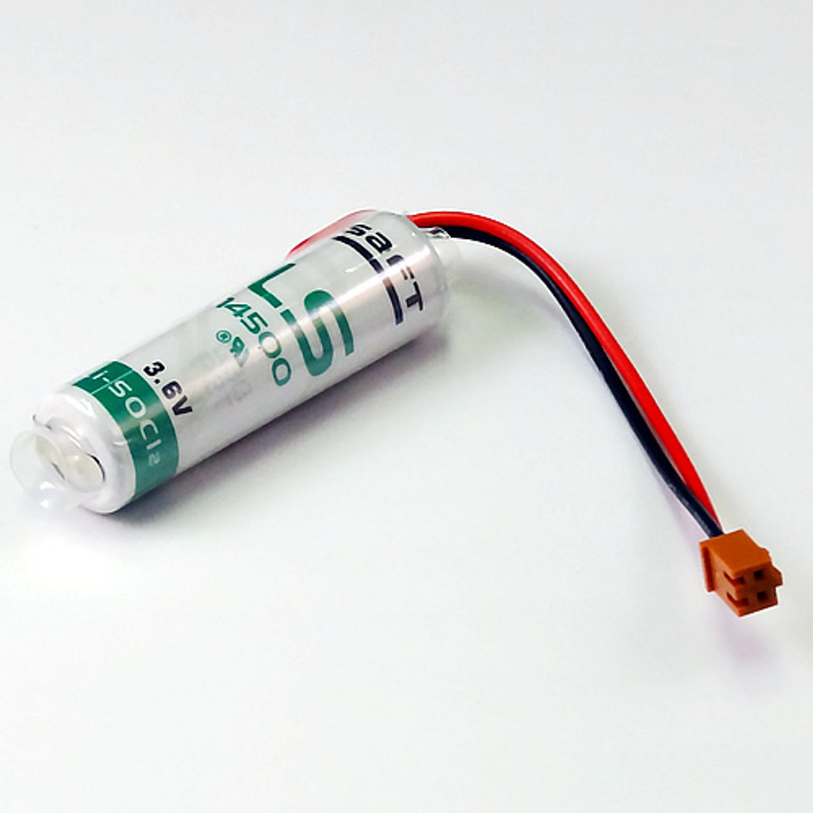
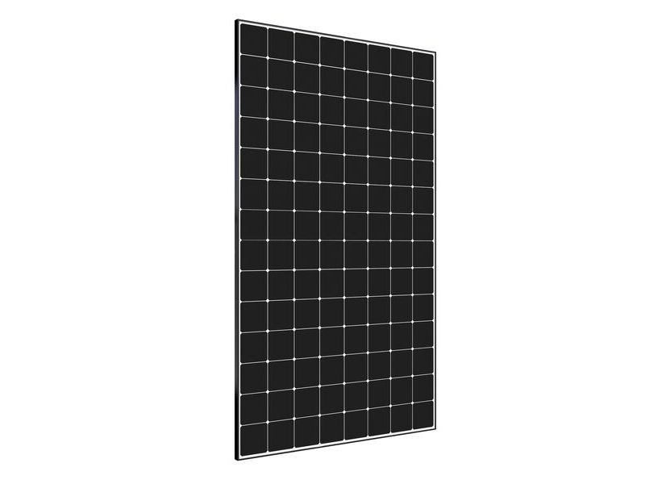
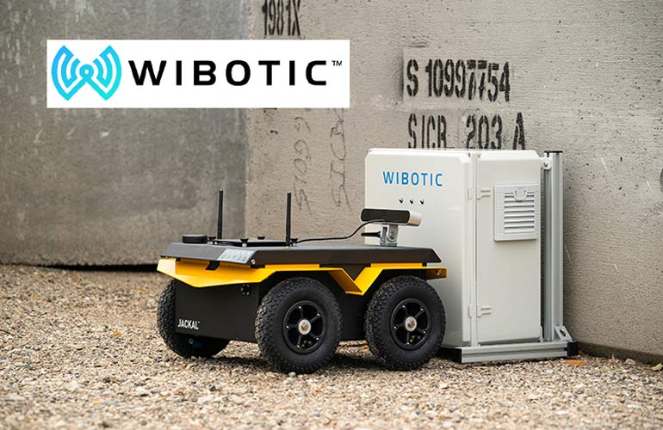
Power Management
Panasonic Lithium-ion Batteries
SunPower High-Efficiency Solar Panels
WiBotic Wireless Charging Solutions
Battery Power
Solar Power
Wireless Inductive Charging

Slide 17
Power Management
Type | Battery Power | Solar Power | Wireless Inductive Charging
Explanation | Battery power involves using rechargeable batteries as a portable energy source for swarm robots. The batteries store electrical energy that is used to power the robot's systems. | Solar power involves using solar panels to convert sunlight into electrical energy to power swarm robots. This method is particularly useful in outdoor environments with access to sunlight. | Wireless inductive charging enables swarm robots to recharge their batteries wirelessly through magnetic fields. The robots align with charging stations to receive power.
Advantages | Portability, versatility, ease of use, relatively low cost. | Renewable and sustainable energy source, long-lasting operation, suitable for extended missions in outdoor environments. | Convenient and seamless charging process, no physical connections or exposed contacts, suitable for swarm robots with frequent docking needs.
Disadvantages | Limited battery life, need for recharging or battery replacement, added weight to the robot. | Dependence on sunlight availability, lower power output compared to other sources, weather-dependent performance. | Limited charging range, decreased efficiency compared to direct connections, potential electromagnetic interference.
Applications | General-purpose swarm robots, indoor navigation, short-duration missions. | Outdoor swarm robots, environmental monitoring, agricultural applications. | Swarm robots with docking stations, continuous operation without human intervention.
Model | Panasonic Lithium-ion Batteries | SunPower High-Efficiency Solar Panels | WiBotic Wireless Charging Solutions

Slide 18
Thank you for your time 😊

